Slide 1


Slide 2


Machine Learning
Electrical Summer Workshops (ESW) 2022
Electrical Engineering Department - Sharif University of Technology
Instructors: Alireza Gargoori Motlagh – Mohammad Mahdi Mirrashid – Ali Nourian

Slide 3
Clustering

Slide 4
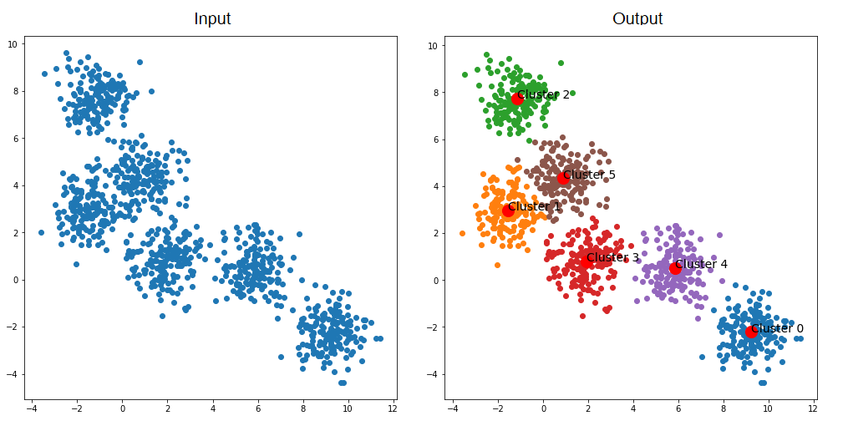
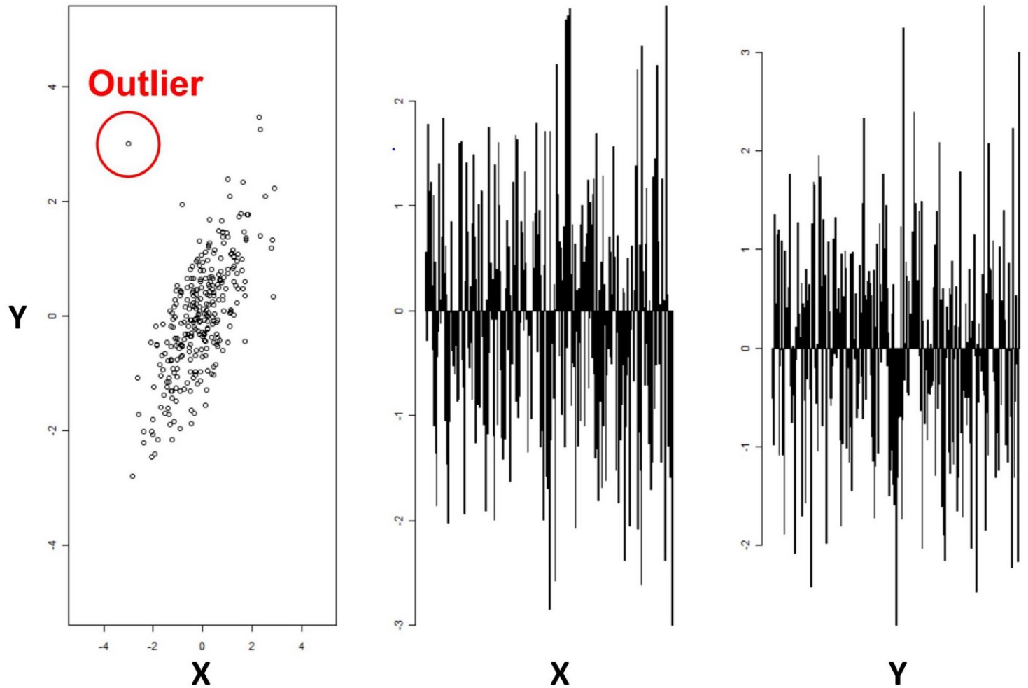

Unsupervised Learning
Unsupervised learning aims to learn patterns in unlabeled datasets
Main applications: Clustering data (k-means),
dimensionality reduction and learning latent-variable models (PCA),
anomaly detection (fraud detection), …
Clustering is the task of grouping data based on their similarities
Dimensionality reduction aims to find latent variables
with high predictive power
Anomaly detection finds outliers. Clustering based
methods exist for this task.
Figure 1. Clustering at the top. PCA at bottom right. Outlier detection at bottom left.

Slide 5
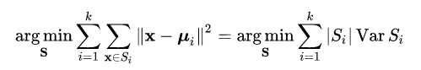
Clustering
Clustering is the task of grouping objects based on their similarities
A cluster is a group of objects such that they are more similar to each other than to objects in other clusters
Different measures of similarity for different applications: Euclidean distance for continuous data, Edit distance for text, Correlation distance for gene expression
Clustering evaluation example: WCSS (Within Cluster Sum of Distances)
Common clustering methods include k-means, hierarchical clustering, EM etc.

Slide 6
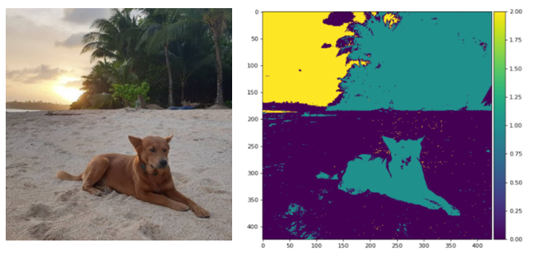
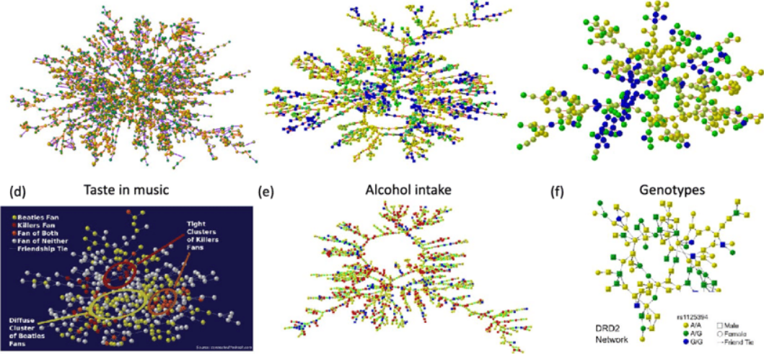
Applications of Clustering
Image processing
Social media analysis (finding like-minded people)
Recommendation engines
Gene sequence analysis
Anomaly detection
Figure 2 . Applications of clustering. Image segmentation at the top and social media user clustering at the bottom

Slide 7
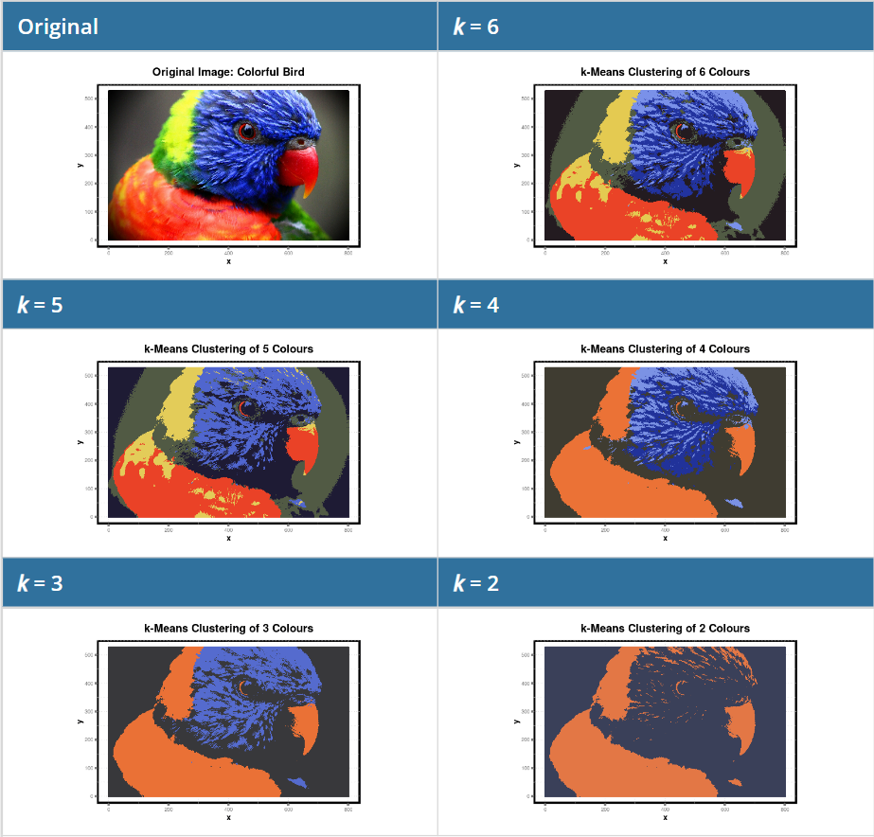
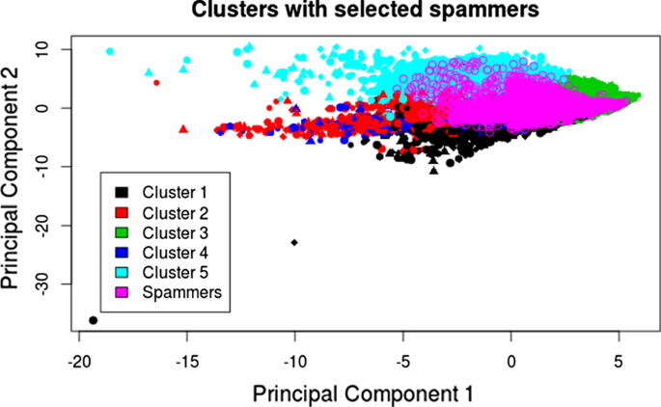
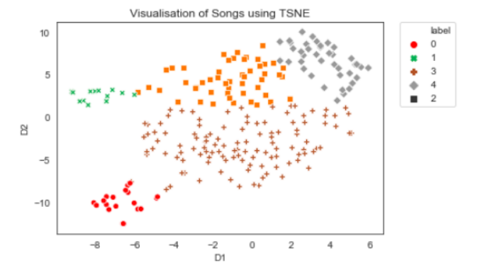
Applications of Clustering
Figure 3. Applications of clustering. Image clustering in the left. Spam detection in top right and Spotify song clustering in bottom right

Slide 8
K-Means
K-means clustering partitions data such that each observation belongs to the data with the nearest mean
Aims to minimize WCSS (defined in page 5)
The problem is computationally difficult (NP-hard) but efficient heuristic algorithms exist for finding a local optima
Minimizing WCSS is equivalent to minimizing within-cluster variances, and so each cluster will contain similar data points
The number of clusters is set as a hyperparameter of the algorithm
Different variations exist for the algorithm: k-medoids minimizes sum of distances for arbitrary distance functions, the EM algorithm assigns probabilistic distributions to clusters, Fuzzy C-Means Clustering uses “soft” clustering and so on

Slide 9
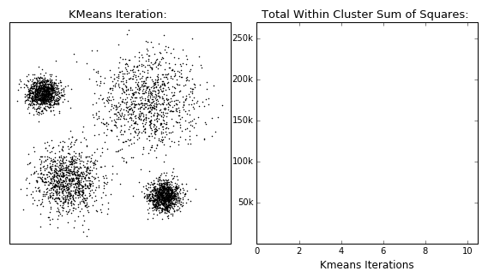
K-Means

Slide 10
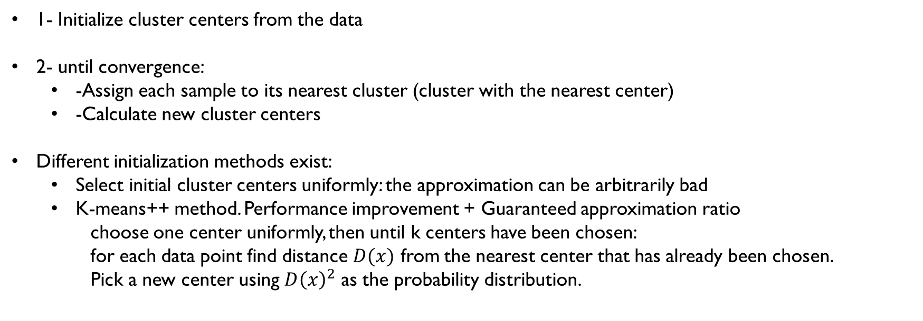
K-Means Algorithm
1- Initialize cluster centers from the data
2- until convergence:
-Assign each sample to its nearest cluster (cluster with the nearest center)
-Calculate new cluster centers
Different initialization methods exist:
Select initial cluster centers uniformly: the approximation can be arbitrarily bad
K-means++ method. Performance improvement + Guaranteed approximation ratio
choose one center uniformly, then until k centers have been chosen:
for each data point find distance $D(x)$ from the nearest center that has already been chosen.
Pick a new center using $D{\left(x\right)}^{2}$ as the probability distribution.

Slide 11
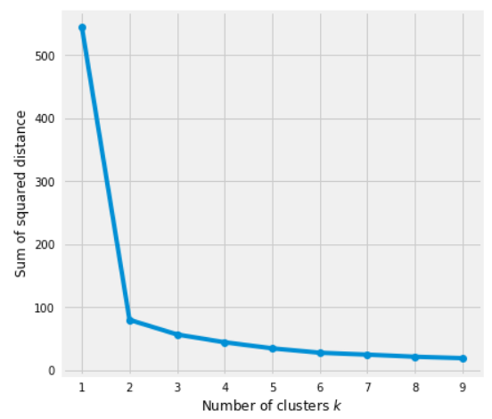
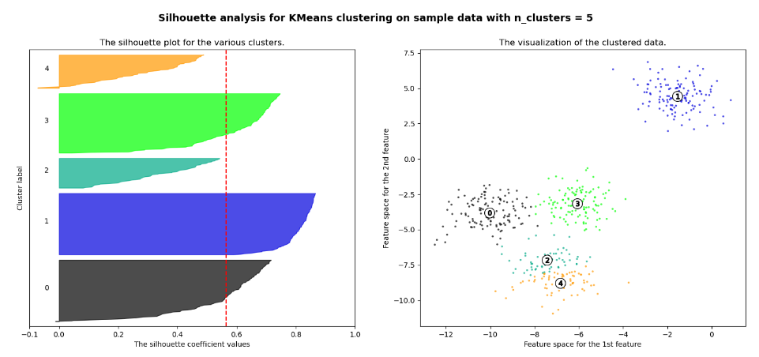
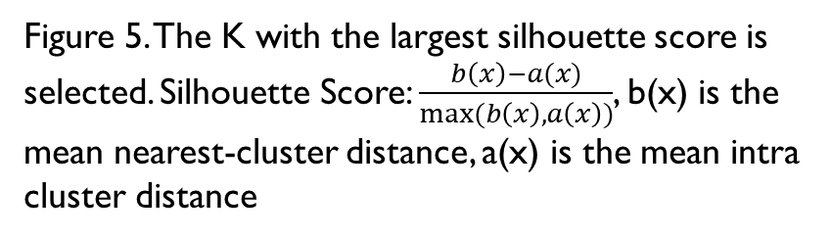
Choosing The Number of Clusters
Figure 5. The K with the largest silhouette score is selected. Silhouette Score: $\frac{b\left(x\right)−a(x)}{max⁡(b\left(x\right), a\left(x\right))}$, b(x) is the mean nearest-cluster distance, a(x) is the mean intra cluster distance
Figure 4. The elbow curve method. Selected K is the point where WCSS has a sharp decrease

Slide 12
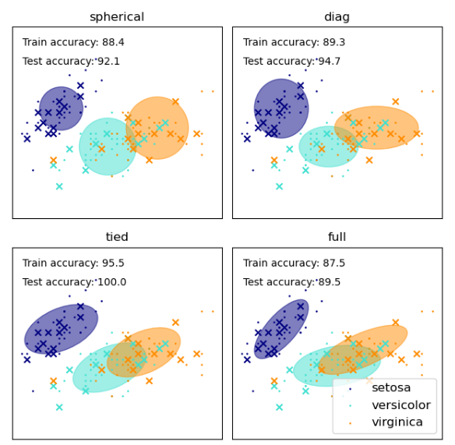
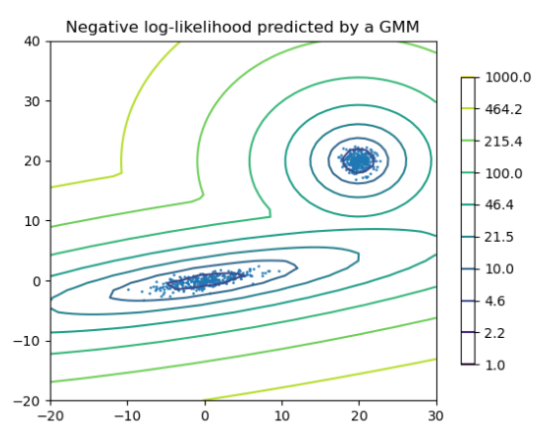
Gaussian-Mixture Models
Assumes data are sampled from a mixture of gaussian distributions
The mean and variance of each distribution is estimated
Figure. Gaussian mixture models. Gaussian distributions are completely described by their variance and means.

Slide 13
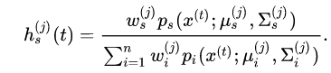
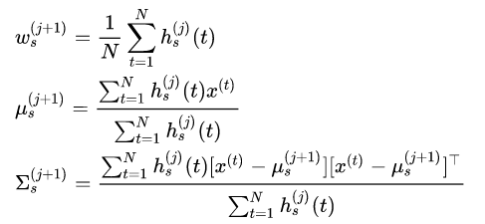
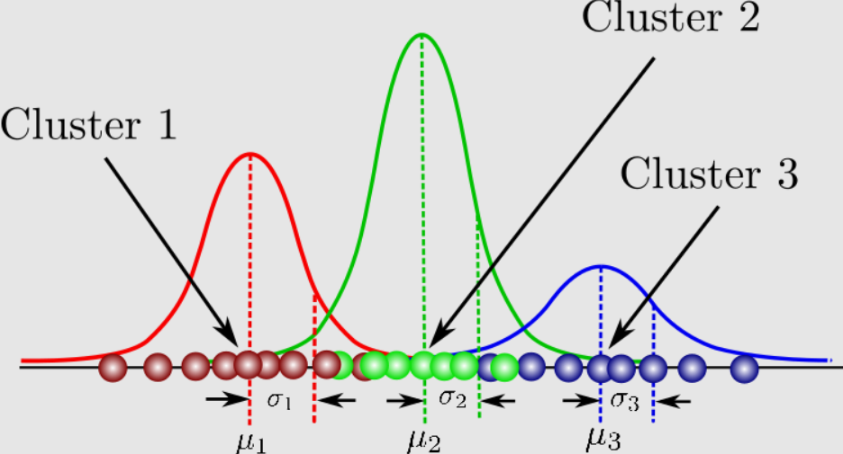
Expectation-Maximization Algorithm
The E-step: Posterior probabilities for each data point is estimated
The M-step: means and variances of each distribution is estimated
These two steps are iterated until convergence
Figure. Estimated probability distributions for data points

Slide 14
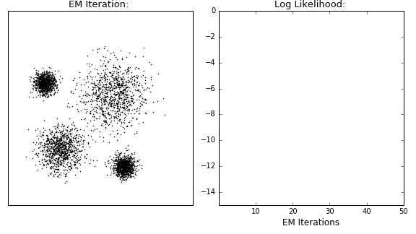
Expectation-Maximization Algorithm

